Slide 1


Direct and Indirect Approach in Writing messages, Good News, Bad News & Persuasive Messages
Business Communication (HS-218) week-7 & 8
Prepared by: Ms Bakhtawar Halepoto

Slide 2
Written messages (based on purpose/response)
We studied Letters and Memos as types of messages based on their format and audience. The third type of business messages is brief written messages based on their purpose and response.
These messages could be:
1- Positive/Goodwill/Good News Messages
2- Negative/ Bad News Messages
3- Persuasive Messages

Slide 3
Direct and Indirect Approach
The direct approach starts with the main idea (such as a recommendation, a conclusion, or a request) and follows that with supporting evidence.
The indirect approach starts with the evidence and builds up to the main idea.

Slide 4
To choose between these two alternatives, analyze your audience’s likely reaction to your purpose and message. Bear in mind, however, the next figure presents only general guidelines; always consider the unique circumstances of each message and audience situation

Slide 5
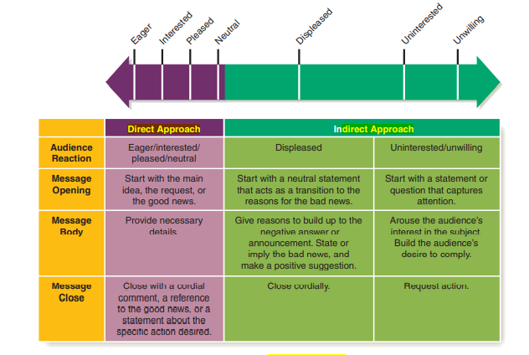
Choosing Between the Direct and Indirect Approaches

Slide 6
Positive/ Goodwill messages
Brief positive messages are also delivered by instant messaging, texting, and social media. When you need information from a team member in another office, you might send an e-mail or use IM.
When you are responding positively to a request, sending routine announcements, or sending a positive or goodwill message, you have several goals: to communicate the information or the good news, answer all questions, provide all required details, and leave your reader with a good impression of you and your firm

Slide 7
Goodwill Messages
Finding the right words to express feelings is often more difficult than writing routine business documents. That is probably why writers tend to procrastinate when it comes to sending goodwill messages expressing thanks, recognition, and sympathy.
Sending a ready-made card or picking up the telephone may seem easier. Remember, though, that the personal sentiments of the sender are more expressive and more meaningful to readers than are printed cards or oral messages. Taking the time to write lends more importance to well-wishing. Personal notes also allow the recipient to reread, savor, and treasure them.

Slide 8
Goodwill notes should always be dispatched promptly. These messages are easier to write while the situation is fresh in your mind. They also mean more to the recipient. A prompt thank-you note carries the hidden message that you care and that the reader is important to you. Instead of learning writing plans for each goodwill message—whether thanks, congratulations, praise, or sympathy—

Slide 9
It is recommended that you concentrate on the five Ss. Goodwill messages should have the following characteristics:
Selfless: Focus the message solely on the receiver, not the sender. When praising others, avoid such comments as I remember when I. . .
Specific: Personalize the message by mentioning specific incidents or characteristics of the receiver. Telling a colleague Great speech is much less effective than Great story about McDonald’s marketing in Moscow. Take care to verify names and other facts.

Slide 10
Sincere: Let your words show genuine feelings. Rehearse in your mind how you would express the message to the receiver orally. Then transform that conversational language to your written message. Avoid pretentious, formal, or flowery language (With the utmost pleasure, I extend felicitations on the occasion of your firm’s twentieth anniversary).
Spontaneous: Keep the message fresh and enthusiastic. Avoid canned phrases (Congratulations on your promotion, Good luck in the future). Strive for directness and naturalness, not creative brilliance.

Slide 11
Short: Although goodwill messages can be as long as needed, try to accomplish your purpose in only a few sentences. Remembering an individual is most important. Such caring does not require documentation or wordiness. Individuals and business organizations often use special note cards or stationery for brief messages.

Slide 12
Positive/ Goodwill Messages includes:
Information about procedures/products/services, options
Announcements of policy/policy changes
Positive answers to reader’s requests
Instructions to staff and employees regarding system/procedures

Slide 13
Purposes of Goodwill/positive messages
Primary purposes
To give information or good news to the reader or reassure the reader
To have the reader read the message, understand it and view the information positively
To deemphasize any negative element

Slide 14
Secondary purposes (for all three types: positive, negative and persuasive)
To build a good image of the writer
To build a good image of the writer’s organization
To cement a good relationship between the writer and the reader
To reduce or eliminate future correspondence on the same subject so the message does not create more work for the writer

Slide 15
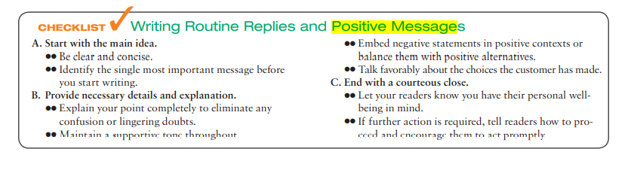

Slide 16
Replying to Goodwill Messages
Should you respond when you receive a congratulatory note or a written pat on the back? By all means! These messages are attempts to connect personally; they are efforts to reach out, to form professional and/or personal bonds. Failing to respond to notes of congratulations and most other goodwill messages is like failing to say You’re welcome when someone says Thank you.

Slide 17

Example:

Slide 18


Slide 19
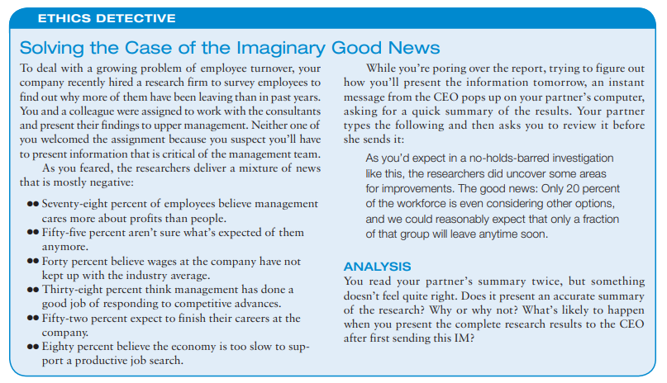
Activity:

Slide 20
Negative/Bad News Messages (Business Communication today, pg. 3420
Communicating negative information is a fact of life for all business professionals, whether it’s saying no to a request, sharing unpleasant or unwelcome information, or issuing a public apology. With the techniques you’ll learn in this chapter, however, you can successfully communicate unwelcome news while minimizing unnecessary stress for everyone involved.

Slide 21
Negative messages include:
Rejection and refusal to requests
Regrets
Announcement of policies having disadvantage to the reader
Negative performance appraisals
Disciplinary notices, notices or defects

Slide 22
A negative message using the direct approach opens with the bad news, proceeds to the reasons for the situation or the decision, and ends with a positive statement aimed at maintaining a good relationship with the audience. In contrast, the indirect approach opens with the reasons behind the bad news before presenting the bad news itself.

Slide 23
Depending on the situation, you can have as many as five distinct goal/purposes when communicating negative information:
(1) to convey the bad news,
(2) to gain acceptance of the bad news,
(3) to maintain as much of your audience’s goodwill as possible,
(4) to maintain a good image for your organization, and, if appropriate,
(5) to reduce or eliminate the need for future correspondence on the matter. Five goals are clearly a lot to accomplish in one message, so careful planning and execution are particularly critical with negative messages.

Slide 24
Steps to write a negative message
Step 1: planning a negative message
Analyse the situation
Be sure to consider your purpose thoroughly—whether it’s straightforward (such as rejecting a job applicant) or more complicated (such as drafting a negative performance review, in which you not only give the employee feedback on past performance but also help the person develop a plan to improve future performance).
Negative messages can be intensely personal to the recipient, and recipients often have a right to expect a thorough explanation of your answer

Slide 25
Selecting the right medium and channel is also important. For instance, bad news for employees should be delivered in person whenever possible.
Defining your main idea in a negative message is often more complicated than simply saying no. For instance, if you need to respond to a hardworking employee who requested a raise, your message might go beyond saying no to explaining how she can improve her performance by working smarter, not just harder.
Finally, the organization of a negative message requires particular care. One of the most critical planning decisions is choosing whether to use the direct or indirect approach

Slide 26
Step 2: writing a negative message
Use respectful words
Do not use negative words
Avoid accusing tone
Step 3: completing a negative message
Be careful about the message detail
Revise your content, make it concise and clear
Proofread and eliminate mistakes

Slide 27
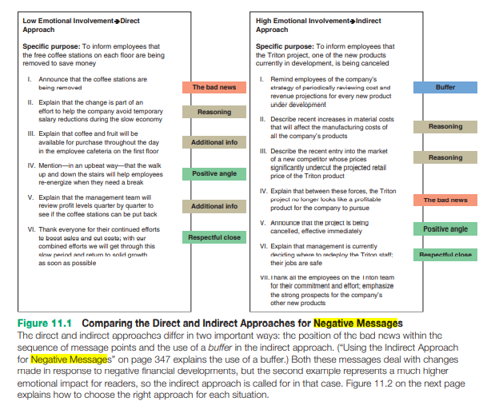

Slide 28
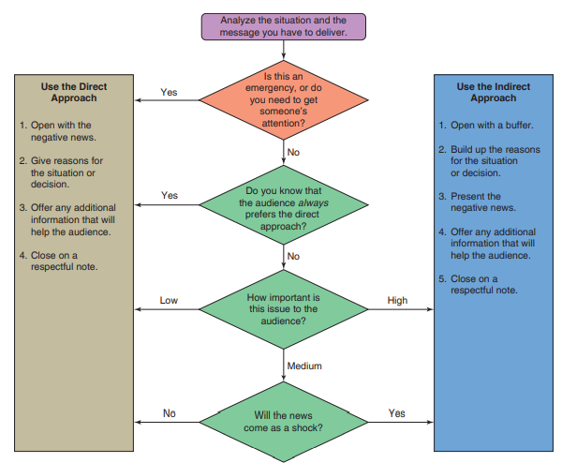
Flow chart for choosing direct or indirect approach in negative messages

Slide 29
Persuasive Messages (Business Communication Today, pg. 378)
persuasive messages ask audiences to give something of value (money in exchange for a product, for example) or take substantial action (such as changing a corporate policy), they are more challenging to write than routine messages. Successful professionals understand that persuasion is not about trickery or getting people to act against their own best interests; it’s about letting audiences know they have choices and presenting your offering in the best possible light.

Slide 30
Persuasive messages include:
Orders, requests
Proposals, recommendation
Sales, fund-raising letters
Job applications
Efforts to change people’s behaviour e.g. Criticism or performace appraisals
Public service messages/Ads e.g. Safe driving

Slide 31
Purposes of persuasive message
To have the reader act
To provide enough information so that the reader knows exactly what to do
To overcome any objections that might prevent or delay action

Slide 32
Steps to write persuasive message
step 1: Gain attention of the reader
Step 2: Create interest in the message
Step 3: Build desire for the reader
Step 4: Enforce action by identifying benefits

Slide 33
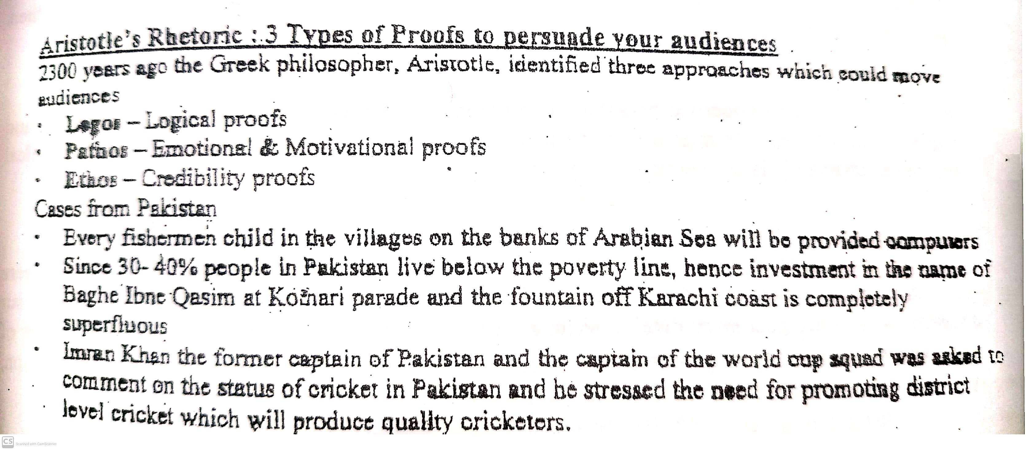

Slide 34
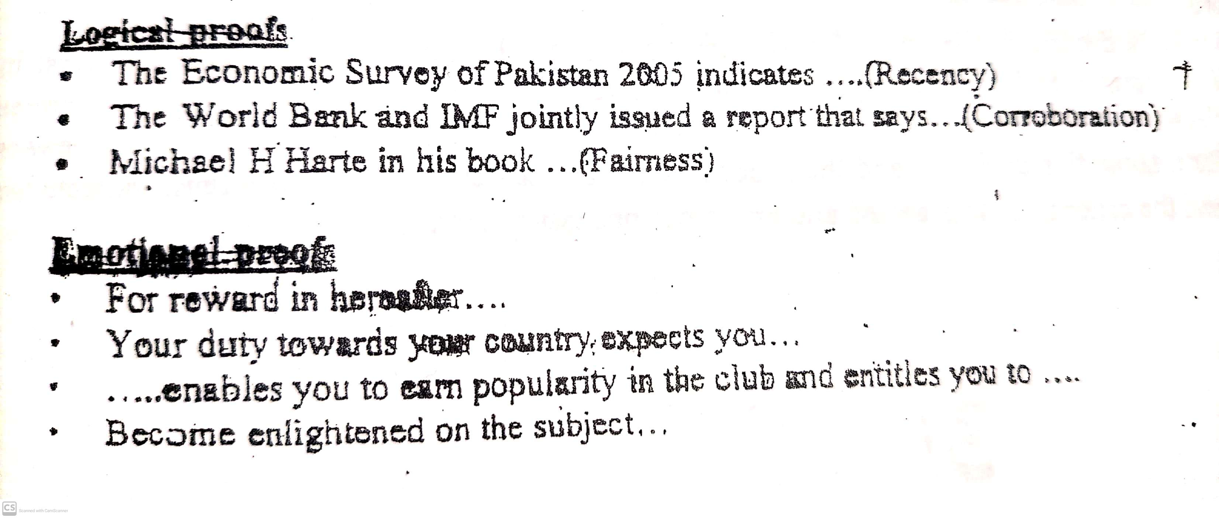

Slide 35
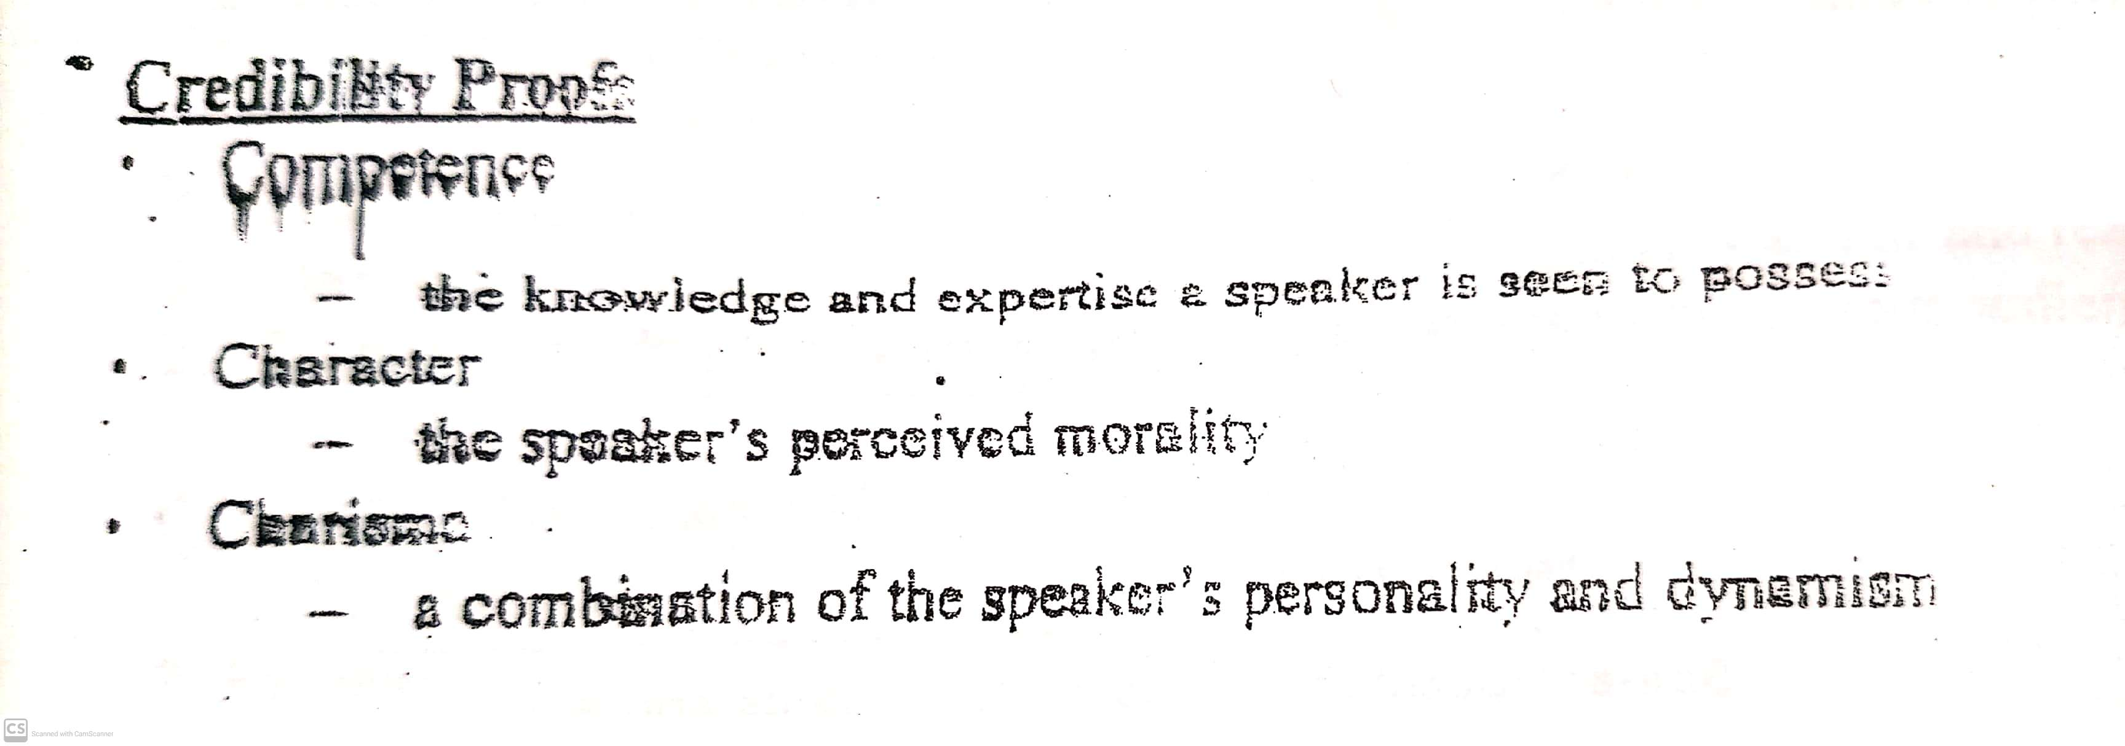

Slide 36
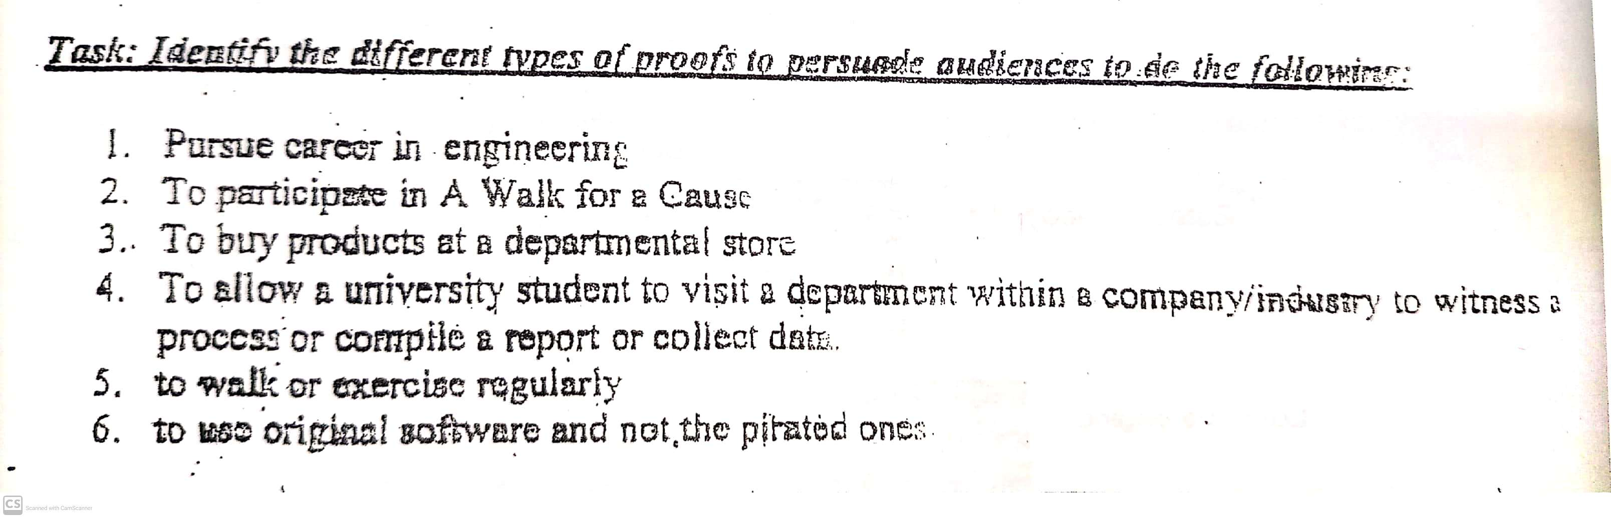
Activity:

Slide 37
Thank you

